Slide 1

Computer Engineering Design 2
School Of Engineering
University of Kwazulu-Natal
South Africa
Project 5:Electrical Cooker Controller
Name: Qaphelani Shezi
Student number: 219015150

Slide 2
Specifications
The system must initially light up a green lamp, and cooking options must be displayed on the SSD.
The system should have a codebook with three cooking options, which are 1: Rice, 2: Meat and 3: Chicken.
The cook option must be displayed continuously while rotating the option number in slow motion.
They should delay for 3 seconds between each option to allow the User to select the option using a Push button.
The Green Lamp must be turned off, and the Red lamp must be turned on after the User selects the cook option.
The cooking time of each option must be 50 seconds for Rice, 75 seconds for Chicken and 90 seconds for Meat.
The cooking time for each option must be displayed in 2 SSDs.
The buzzer must be set after 5 seconds when the required temperature for cooking is met.
The cooking temperature for each cooking option is 27°C for Rice, 30°C for Meat and 27°C for Chicken.
The system must display the option of using and descending the timer.
When it finishes cooker finish cooking (timer = 0), the green lamp light is set on, and the red light is set off and buzzes is set off.

Slide 3
Solution Approach and components
One Push Button switches was used for selecting cooking option.
Two Seven segment Displays to display Temperature were used.
7 220 ohms current limiting resistor were used to reduce the current into the SSD.
10k ohms resistors were used as pull-down the Buttons.
LM35 was used to get the ambient temperature to be displayed
PIC16F690 was used for converting Temperature from the LM35 then display it in the SSD.
Buzzer to indicate that the Cooker has started cooking
Green and Red LED was used for indicating the cooking state.

Slide 4
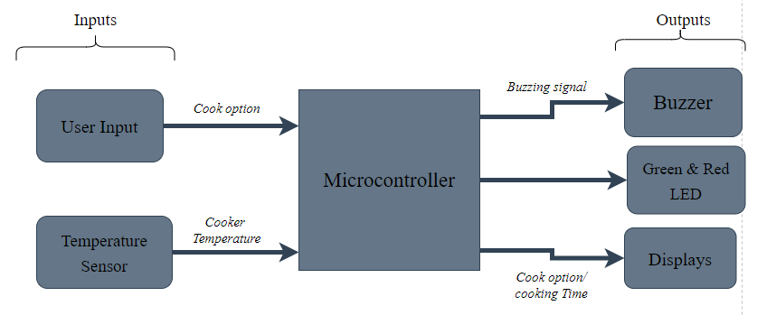
Block Diagram

Slide 5
Implementation Details
Most of the code and solutions of this project have been designed and implemented in the previous project. This includes:
Displaying on SSD – used in project 2, 3 and 4
Binary to BCD Algorithm – Used in project 1, 3 and 4
Counting Down in SSD – Used in project 2, 3 and 4
Temperature Reading – Used in project 3 and 4

Slide 6
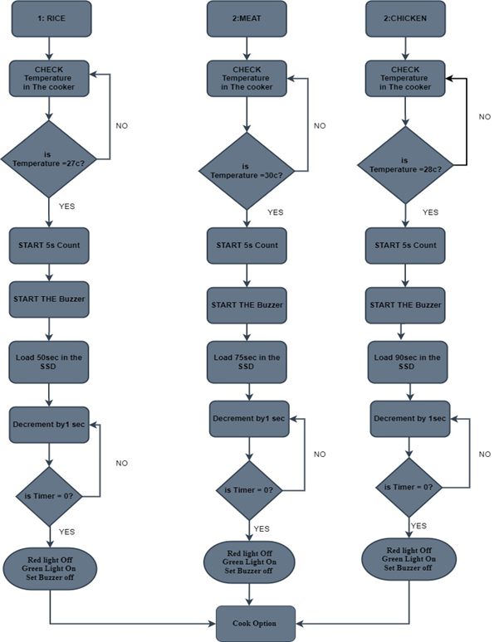
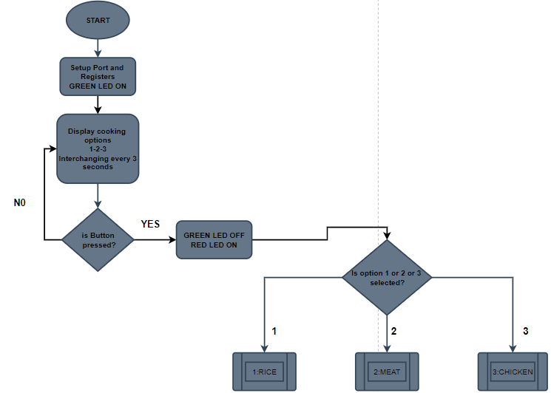
Software Implementation and Code Structure

Slide 7
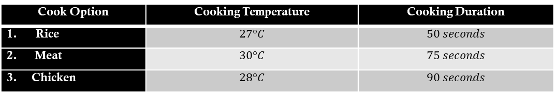
Software Implementation and Code Structure
From the flowcharts and discussion, a summary of the working principle of the electric cooker can be seen in the tables below:
Button State | Green LED | Red LED | Buzzer
Not Pressed | ON | OFF | OFF
After Pressed | OFF | ON | ON
Cook Option | Cooking Temperature | Cooking Duration
Rice | $$27°C$$ | $$50 seconds$$
2. Meat | $$30°C$$ | $$75 seconds$$
3. Chicken | $$28°C$$ | $$90 seconds$$

Slide 8
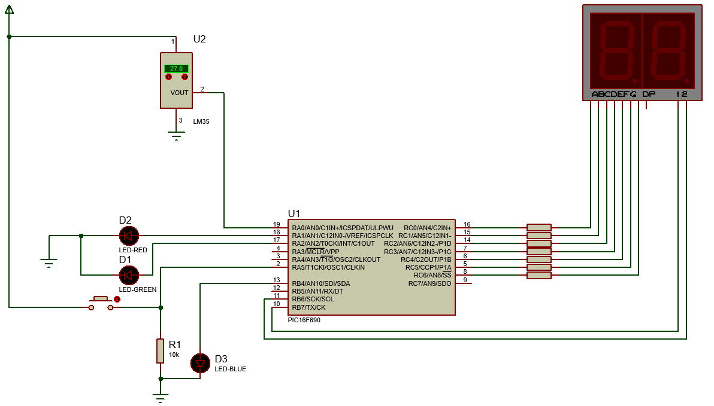
Circuit Simulation

Slide 9
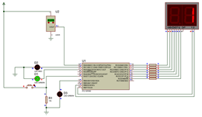
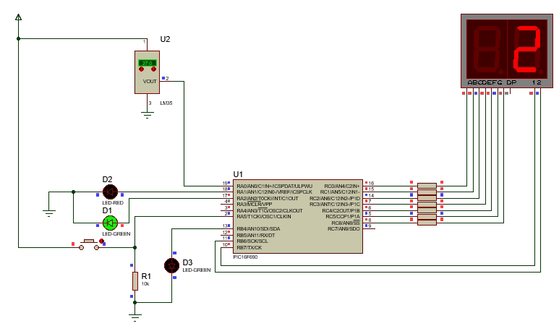
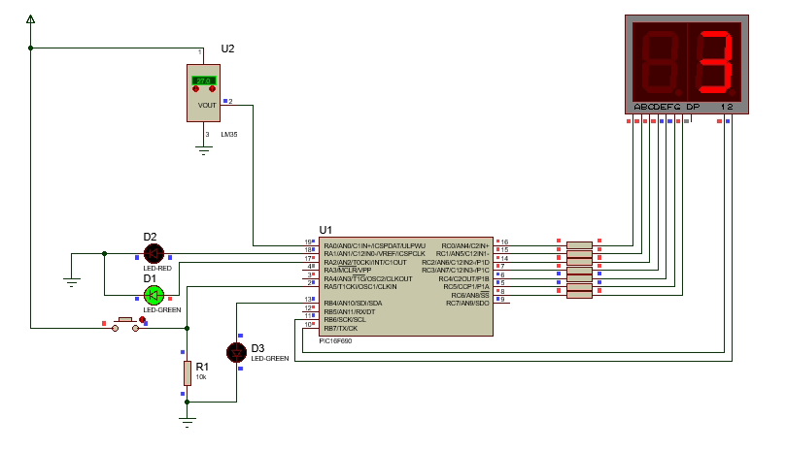
Simulation Testing
Initially when the button is not pressed, The system light up the Green light and continuously displays the menu in the SSD.

Slide 10
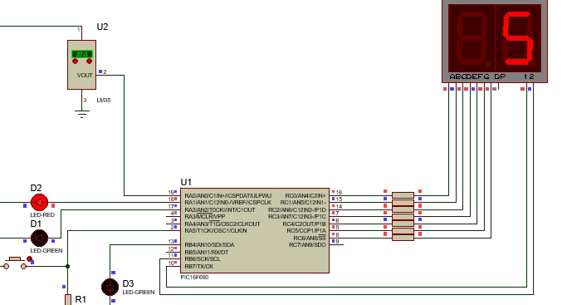
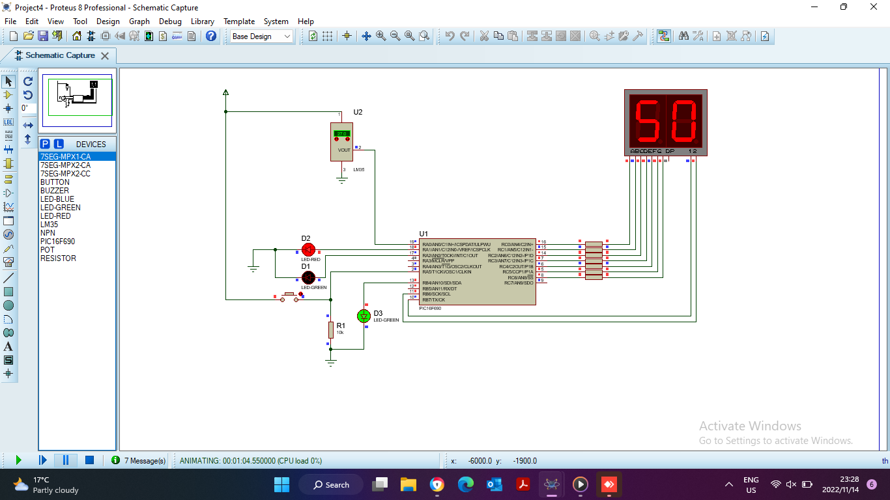
Simulation Testing
Once the Button is pressed the Green LED turns OFF and the Red LED turns ON. And if the first option is selected the following happens:

Slide 11
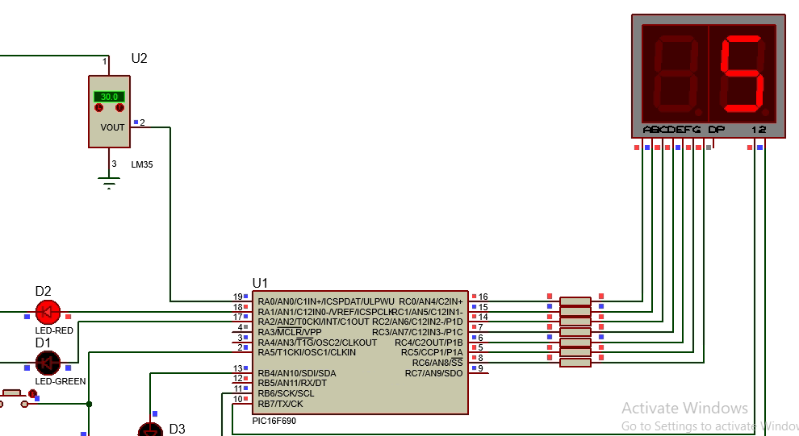
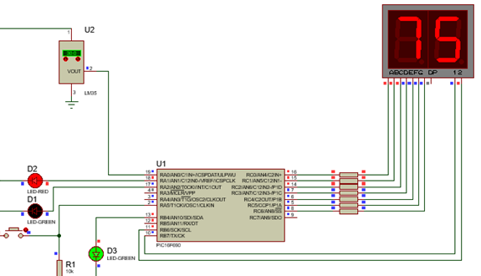
Simulation Testing
Once the Button is pressed the Green LED turns OFF and the Red LED turns ON. And if the second option is selected the following happens:

Slide 12
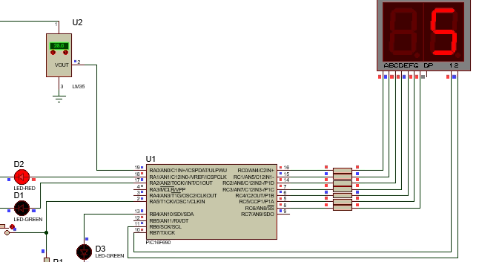
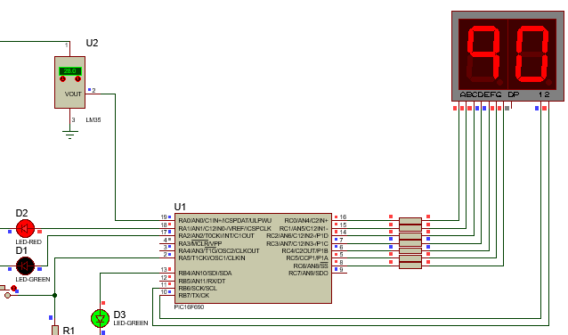
Simulation Testing
Once the Button is pressed the Green LED turns OFF and the Red LED turns ON. And if the third option is selected the following happens:

Slide 13
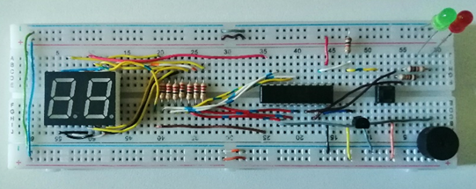
Prototype Circuit
The Project was successfully implemented in the breadboard and the picture in this slide shows the implementation of the circuit.

Slide 14
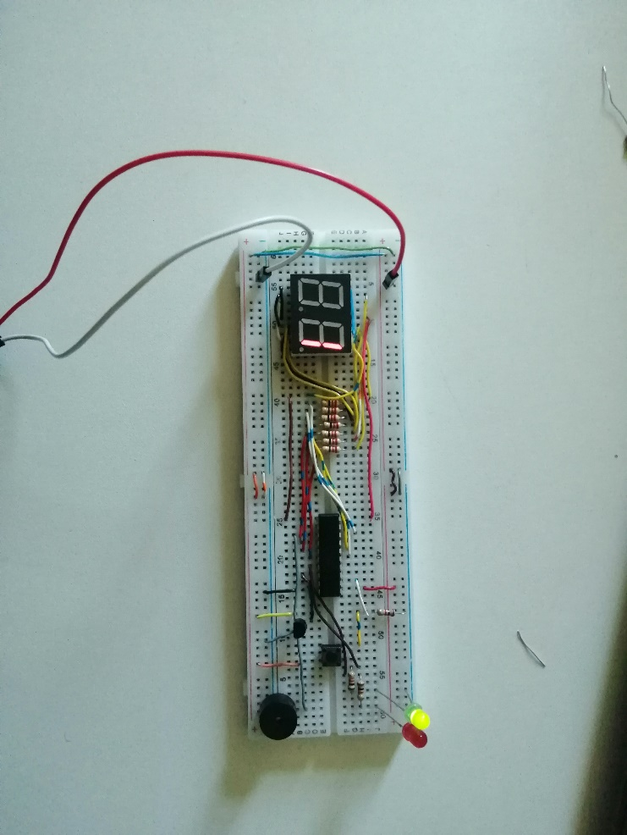
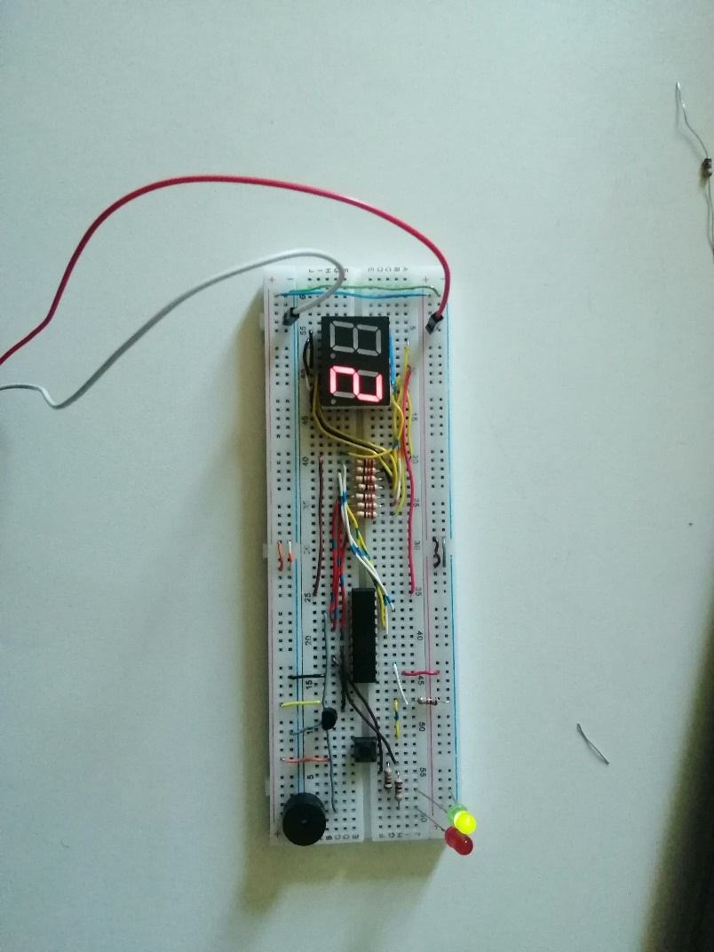
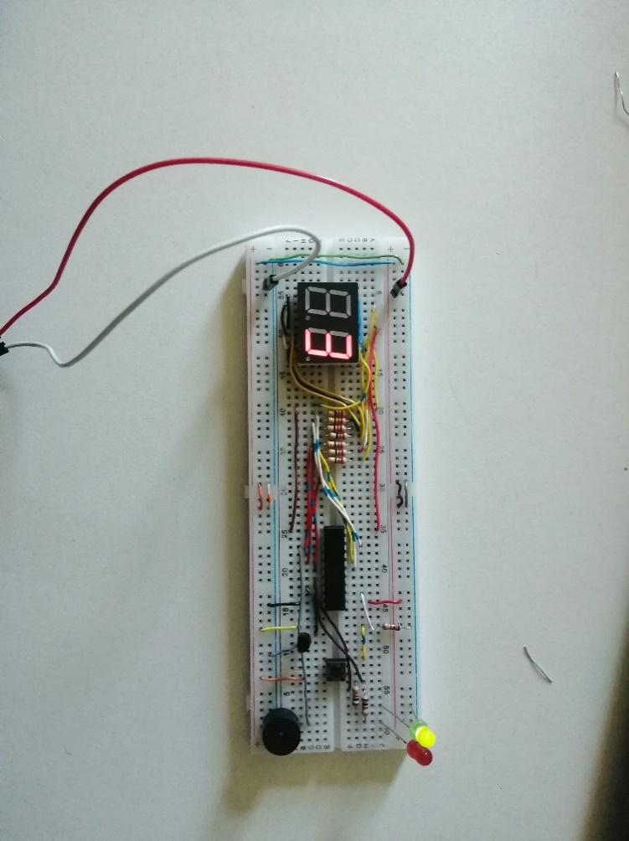
Prototype Testing Results
Initially when the button is not pressed, The system light up the Green light and continuously displays the menu in the SSD.

Slide 15
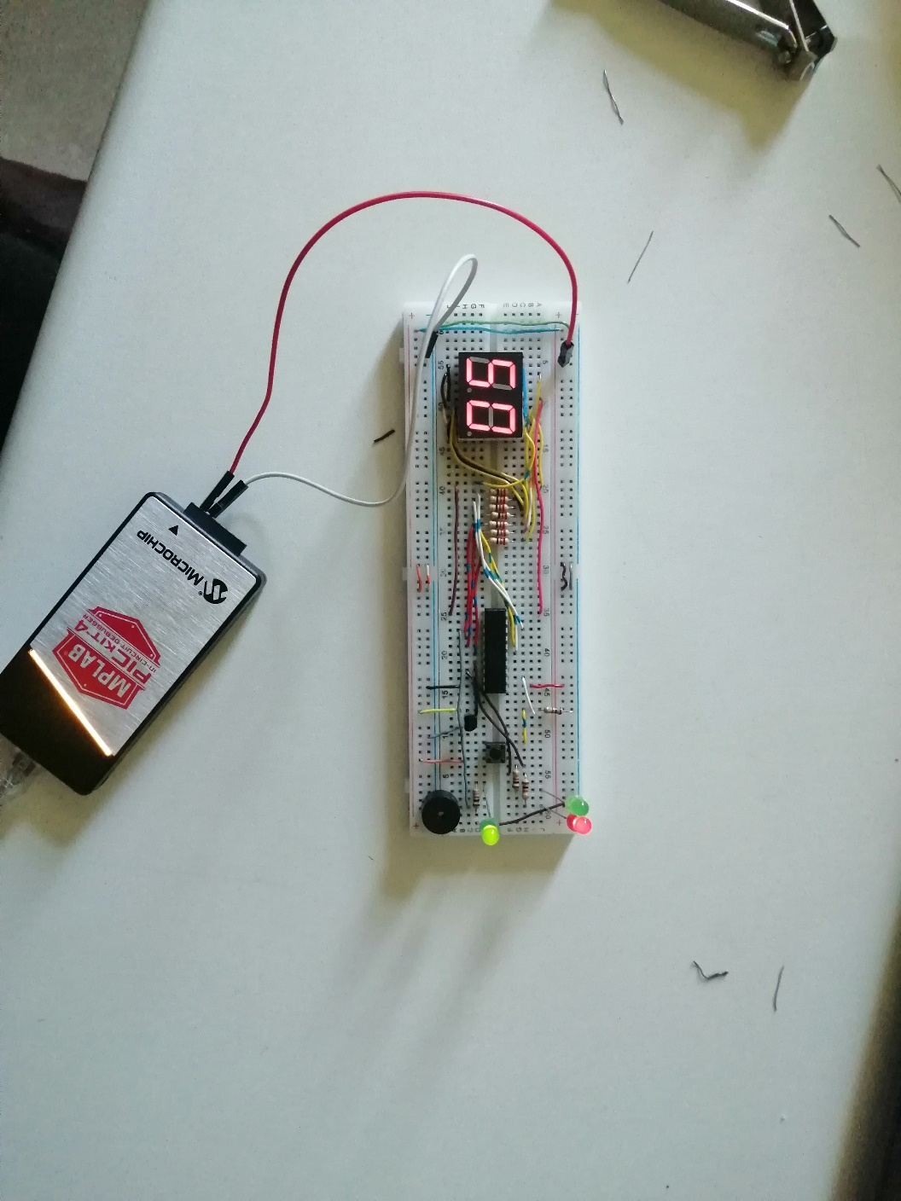
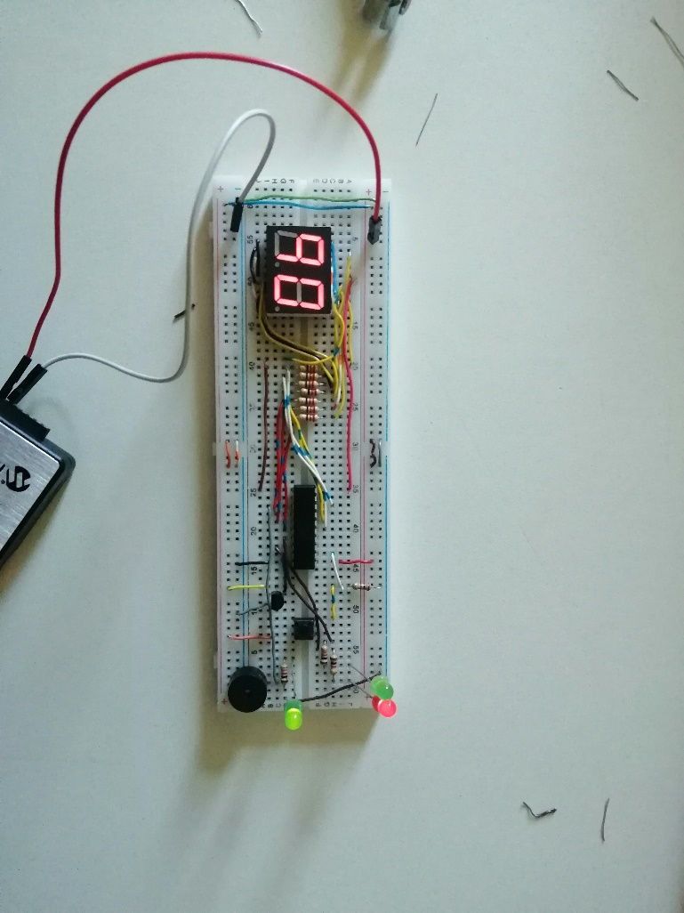
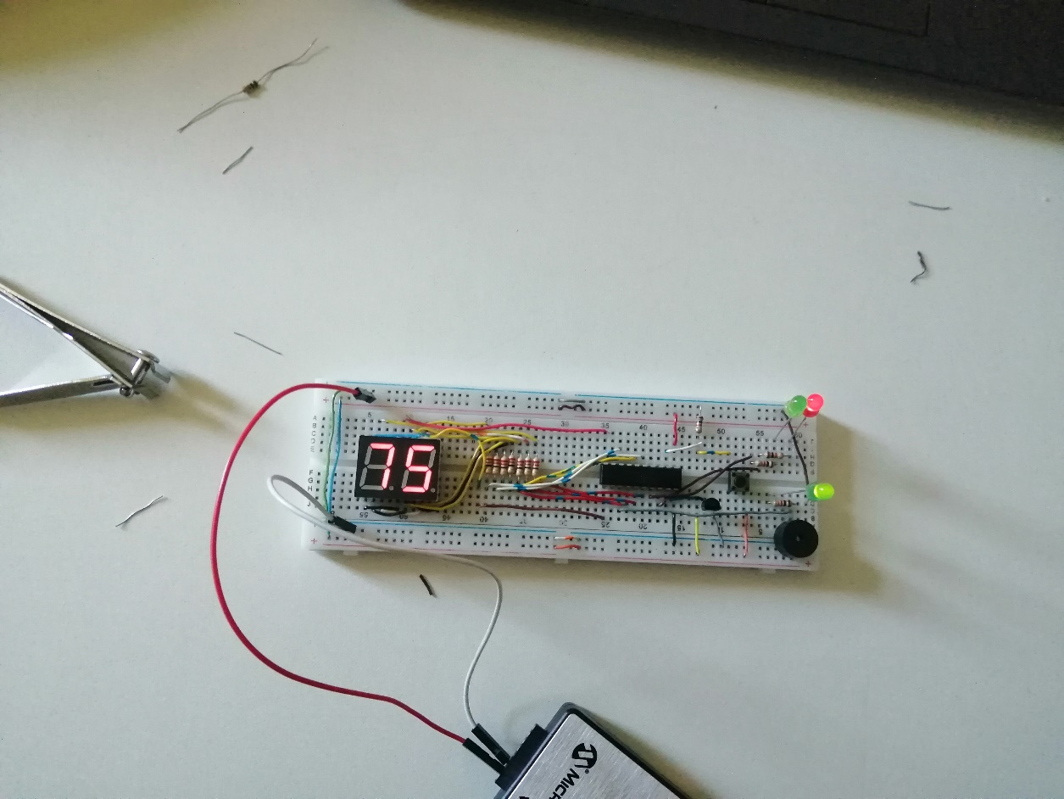
Simulation Testing
Once the Button is pressed the Green LED turns OFF and the Red LED turns ON. And if the first , second and third option is selected the following happens:

Slide 16

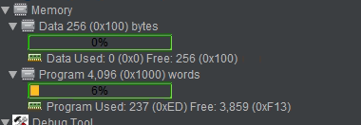
Code Performance
The program builds successfully and fast.
The code designed for the Electrical cooker controller was efficient.
The total lines of code is 388 lines

Slide 17
Time Taken and Lesson Learnt
The time to complete this project was approximately 5 to 8 hours, spread over two weeks
Debugging code and troubleshooting the breadboard connection consumed most of the time taken.
The project provide insight and knowledge into how hardware-related tasks might be approached and the necessity of locating the appropriate components for execution

Slide 18
Conclusion
The goal of this project was designing the Electrical cooker controller using PIC16F690 microcontroller.
The goal was successfully met and all the specifications of the project were met.
In future, the project can be extended by implementing the Cooker and changing the SSD to an LCD to allow the visualisation of the cooking Temperature and cooking option name.

Slide 19

THANK YOU

